Slide 2
POWER OF ONE
BEHIND GLOBAL UNREST

Slide 4
OSAMA BIN LADEN

Slide 5
YASSER ARAFAT Late PLO Leader

Slide 6
SHEIKH YASSIN Founder of HAMAS

Slide 7
MUNIR AL MAKDAH Jihadee

Slide 8
LOULA ABBOUD

Slide 9
SHEIKH HASSAN AL FADLULLAH Founder of Hezbollah

Slide 10
POWER OF ONE
GLOBAL PEACEMAKERS

Slide 11
BISHOP DESMOND TUTU

Slide 12
DALAI LAMA

Slide 13
MUHAMMAD YUNUS

Slide 14
POWER OF ONE
SHARIFA AL KHATTEEB
HASSINA SHERJAN

Slide 15
POWER OF ONE
EVERYDAY HEROES

Slide 16
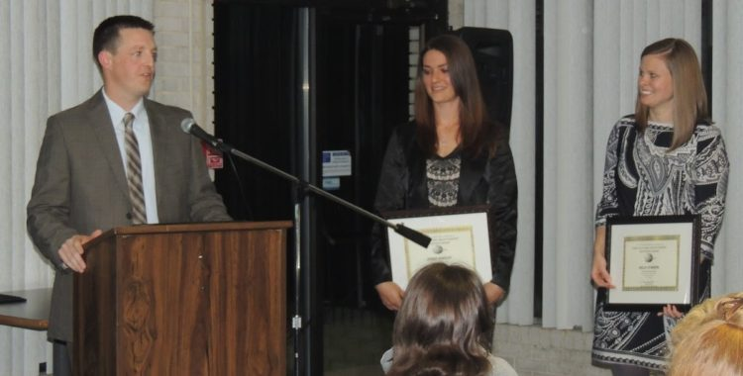
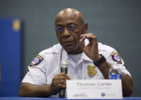
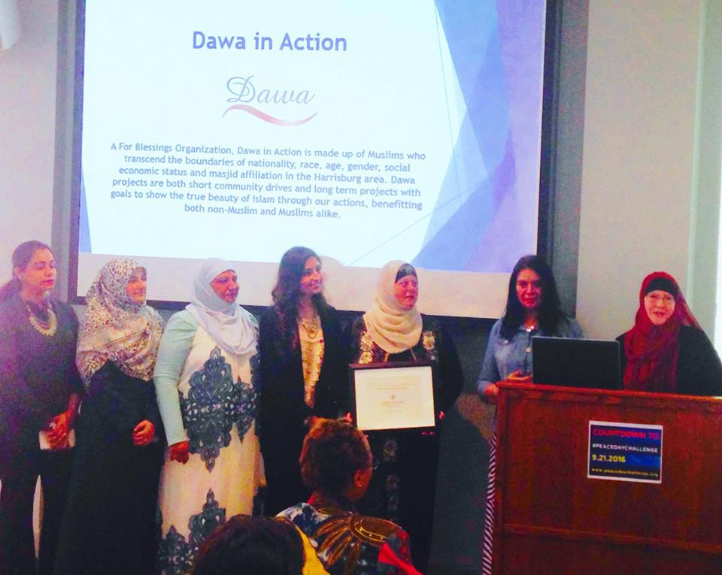
THE POWER OF ONE Closer to Home
The Rev. Nathaniel and Pat Gadsden
MILTON HERSHEY SCHOOL TEACHERS
Jamie Kinsley, Kelly O’Brien Tom Sites
Harrisburg Police Chief Thomas C. Carter
DAWA IN ACTION

Slide 17
WHAT ABOUT US?

